Slide 1



Mini-Bot Coding Challenge
Shelby Ryan

Slide 2
Timeline – 6 Weeks – 12 Classes
Week 1:
Class 1: Project overview, Build Mini-Bot
Class 2: Build Mini-Bot
Week 2:
Class 3: Interface with the Rev Controller
Class 4: Introduction to Programing with OnBot Java
Week 3:
Class 5: Differential VS. Omni-Directional drivetrain design
Class 6: Differential VS. Omni-Directional drivetrain design continued
Week 4:
Class 7: Introduction to buttons
Class 8: Introduction to color sensor
Week 5:
Class 9: Field Centric VS. Driver Centric controls, introduction to built in Gyroscope/Accelerometer
Class 10: Great Coding Challenge Introduction
Week 6:
Class 11: Open work day for Great Coding Challenge
Class 12: Open work day for Great Coding Challenge

Slide 3
What is Mini-Bot?
PICTURE OF MINI BOT
Mini-Bot was created to provide the programming team a physical test bench to learn critical coding skills
Mini-Bot is a 3D printed, 4 wheel drive robotics platform based around the Rev Control Hub
Equipped with 4 omni-directional Mecanum wheels, Mini-Bot when programmed correctly can move in any direction
Room for expansion, add Cat ears, integrate sensors, modify existing parts, etc…

Slide 4
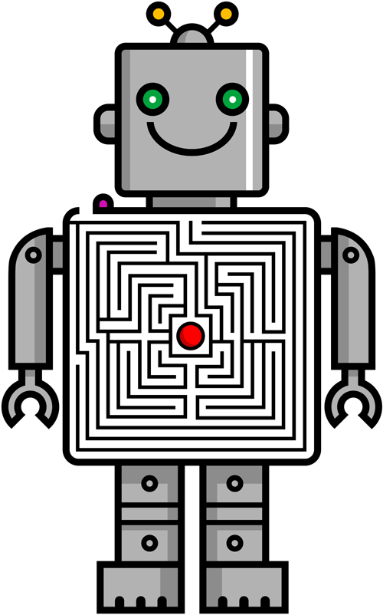
What is the Great coding challenge?
The Great Coding Challenge is a final challenge given to students who complete all 9 Mini-Bot lessons
The challenge will test your driving and coding skills in a competitive race to the finish line!
Cant spoil all the fun yet, your going to have to wait till lesson 10 to find out more information

Slide 5
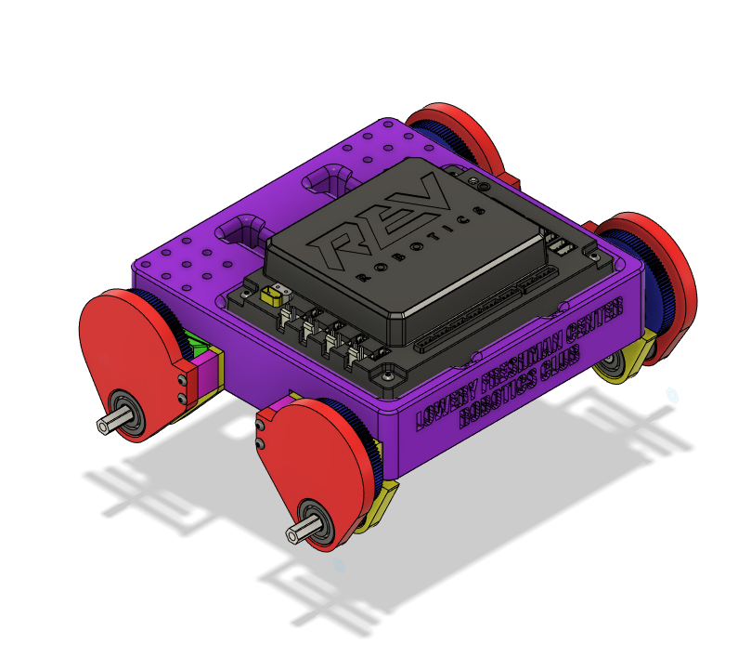
Lesson 1: Build Mini-Bot
Mini-Bot was designed to be easy to build and modify
The Bot can be split up into a few key areas, you have the Control Hub, Chassis, and Motor Pods
Control Hub (Black Part): Main Brain of the robot, handles power distribution, executes commands and send signals to motors
Chassis (Purple Part): Holds everything together, helps manage cables, provides areas to mount accessories like sensors
Motor Pods (Red/Yellow Parts) : The Motor Pods increase the RPM (rotations per minute) of the wheels by amplifying the motor speed by 5.3!

Slide 6
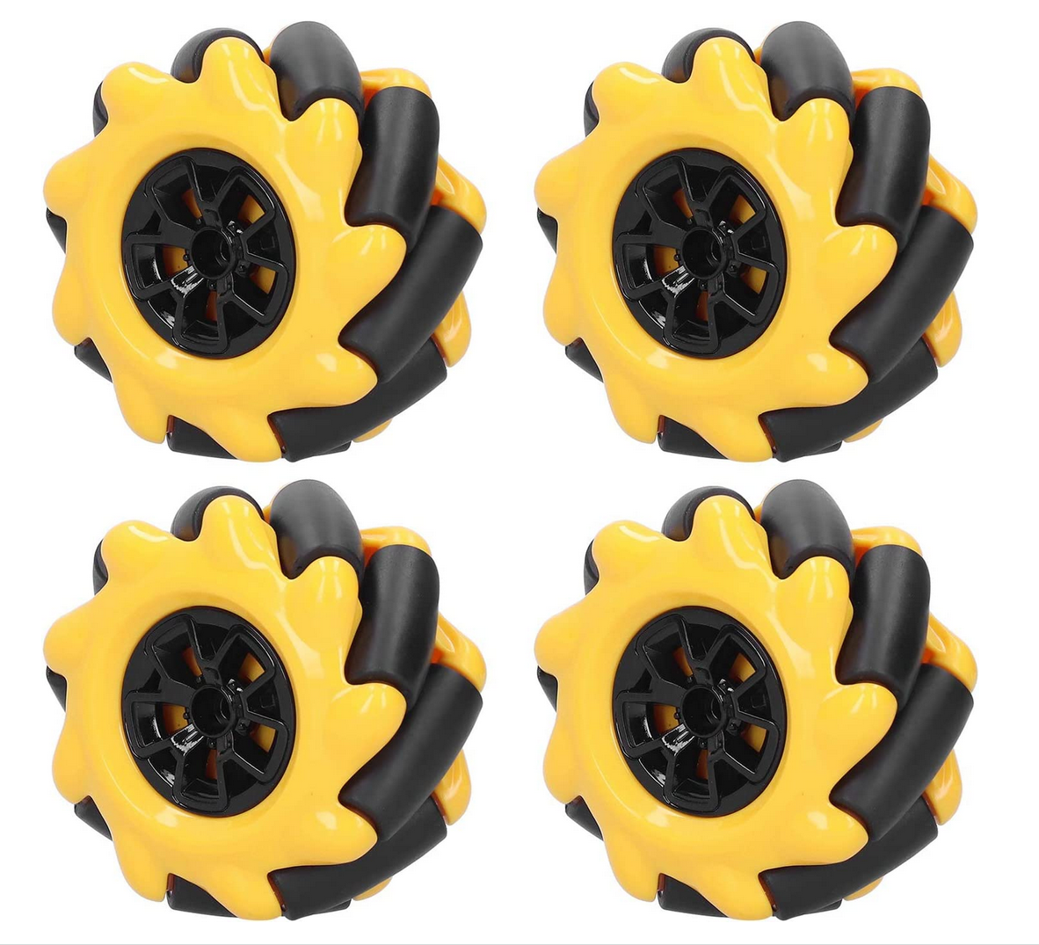
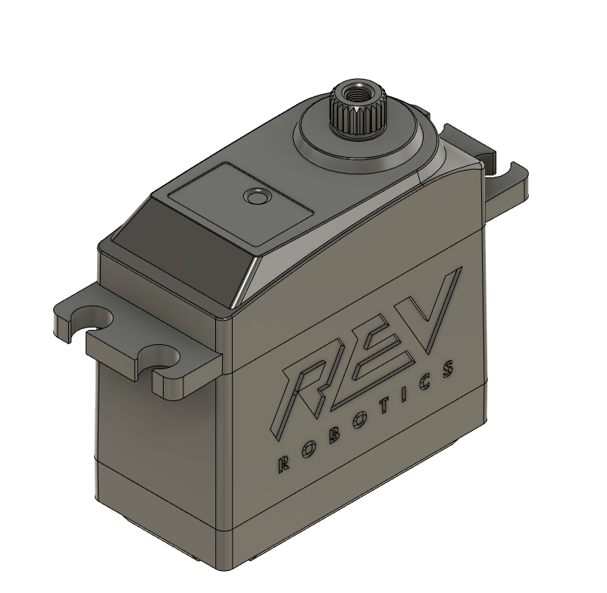
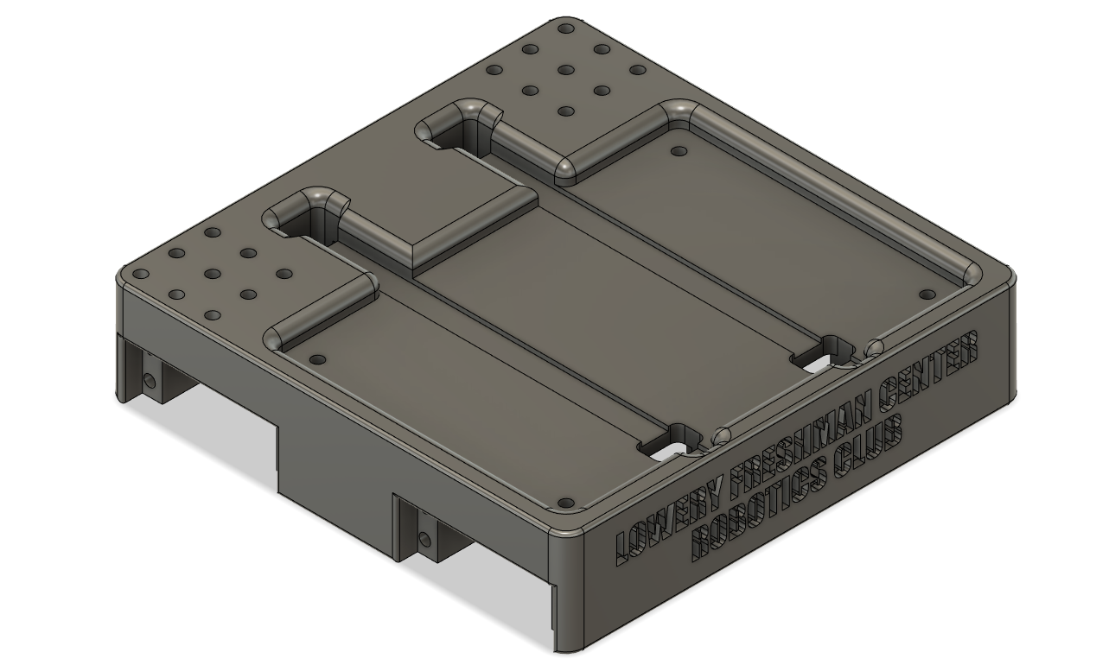
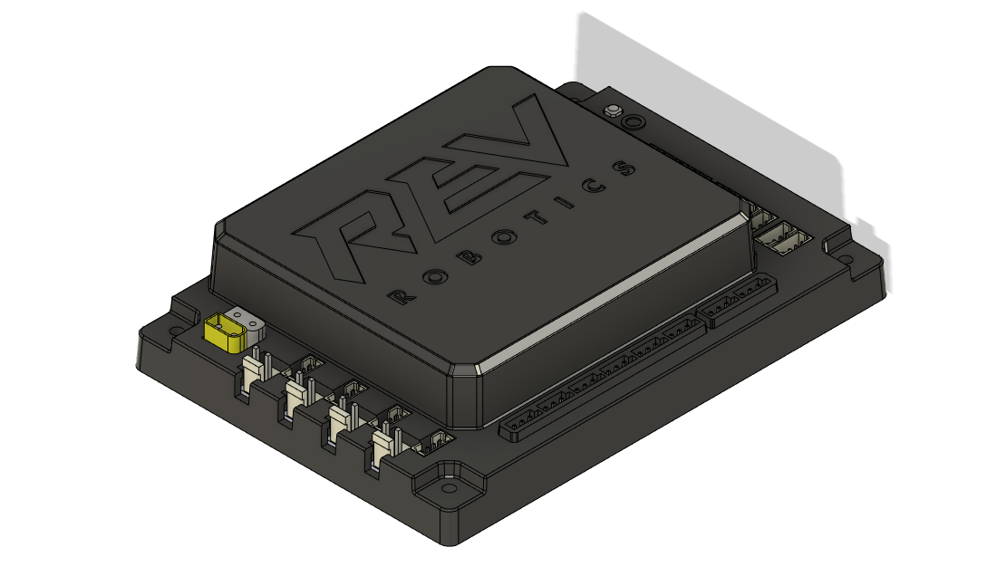
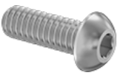
Bill of Materials - BOM
1x set of 4 Omni-Directional Mecanum wheels
4x Rev Robotics Smart Servos in Continuous Mode
1x Rev Control Hub
1x Chassis
4x wheel adapters
Assorted Hardware:
If your team is missing any parts, please inform a Mentor so we can get you a spare!
Mecanum Wheels
Rev Smart Servo
Chassis
Rev Control Hub
Assorted Hardware

Slide 7
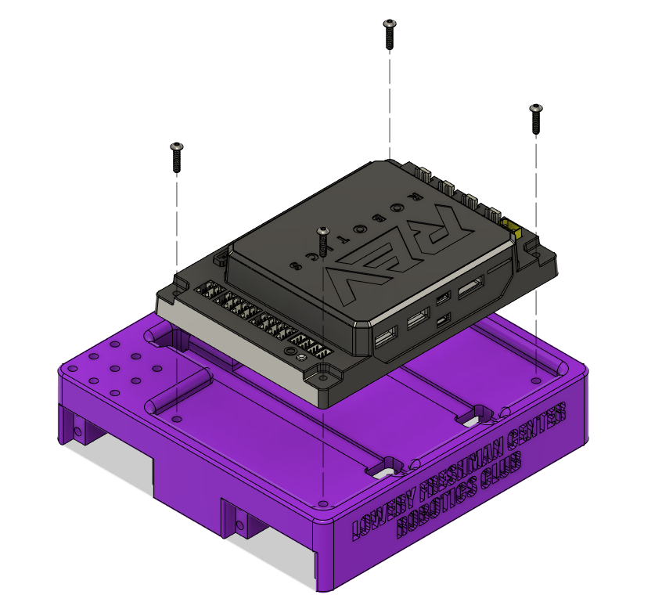
Mini Bot Build Instructions
Parts Needed:
Rev Control Hub
Chassis
4x 4-40 ½” button head screw
Steps:
Place the Rev Control Hub into the large square cutout on the top of the chassis
Secure the Rev Control Hub to the chassis with four 4-40 ½” long screws

Slide 8
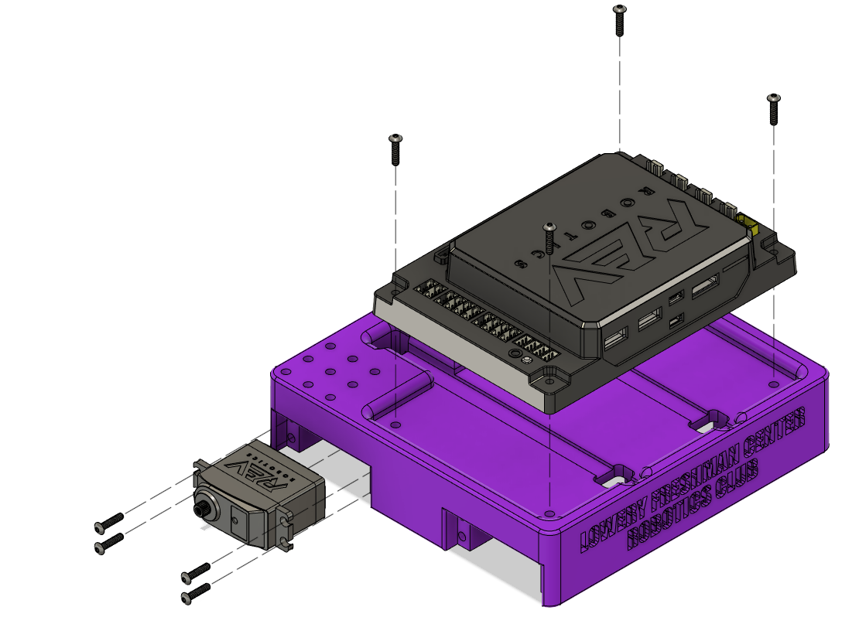
Mini Bot Build Instructions
Parts Needed:
4x Rev Smart Servos
16x 4-40 ½” button head screw
Steps:
Insert a servo into one of the 4 cutouts in the perimeter of the chassis
Ensure the motor hub is closest to the front or back of the chassis
Secure the servo with four 4-40 ½” button head screws
Repeat this step 3 more times to secure all servos to the chassis
Motor Hub Must face front or back of chassis

Slide 9
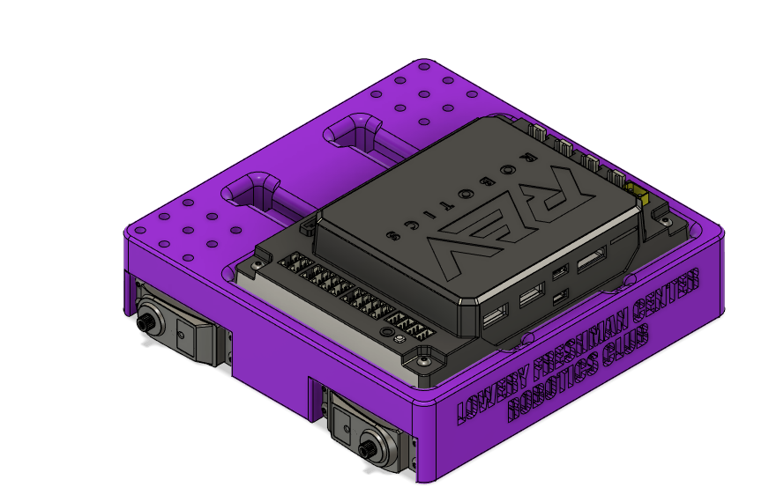
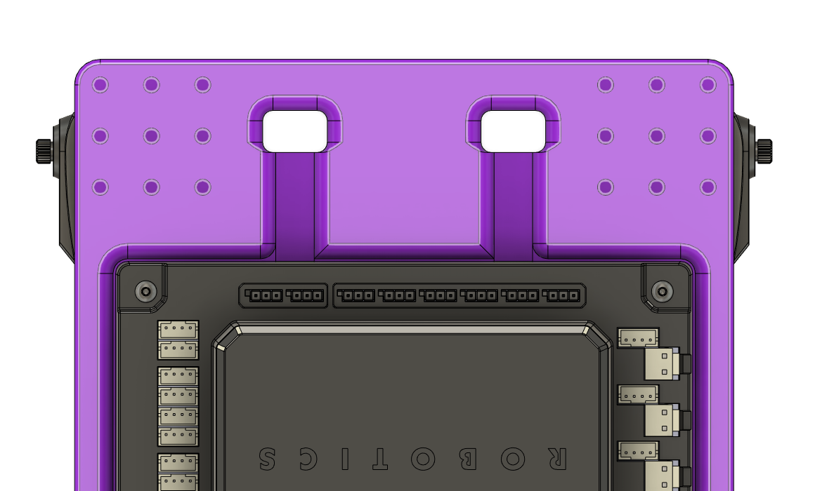
Mini Bot Build Instructions
Chassis Cutouts
Steps:
Route each servo cable through the two cutouts in the chassis to the Rev Control Hub
Connect the servos to ports 0-3 following the diagram below
Servo Ports
Port | Servo
0 | frontLeftServo
1 | backLeftServo
2 | frontRightServo
3 | backRightServo

Slide 10
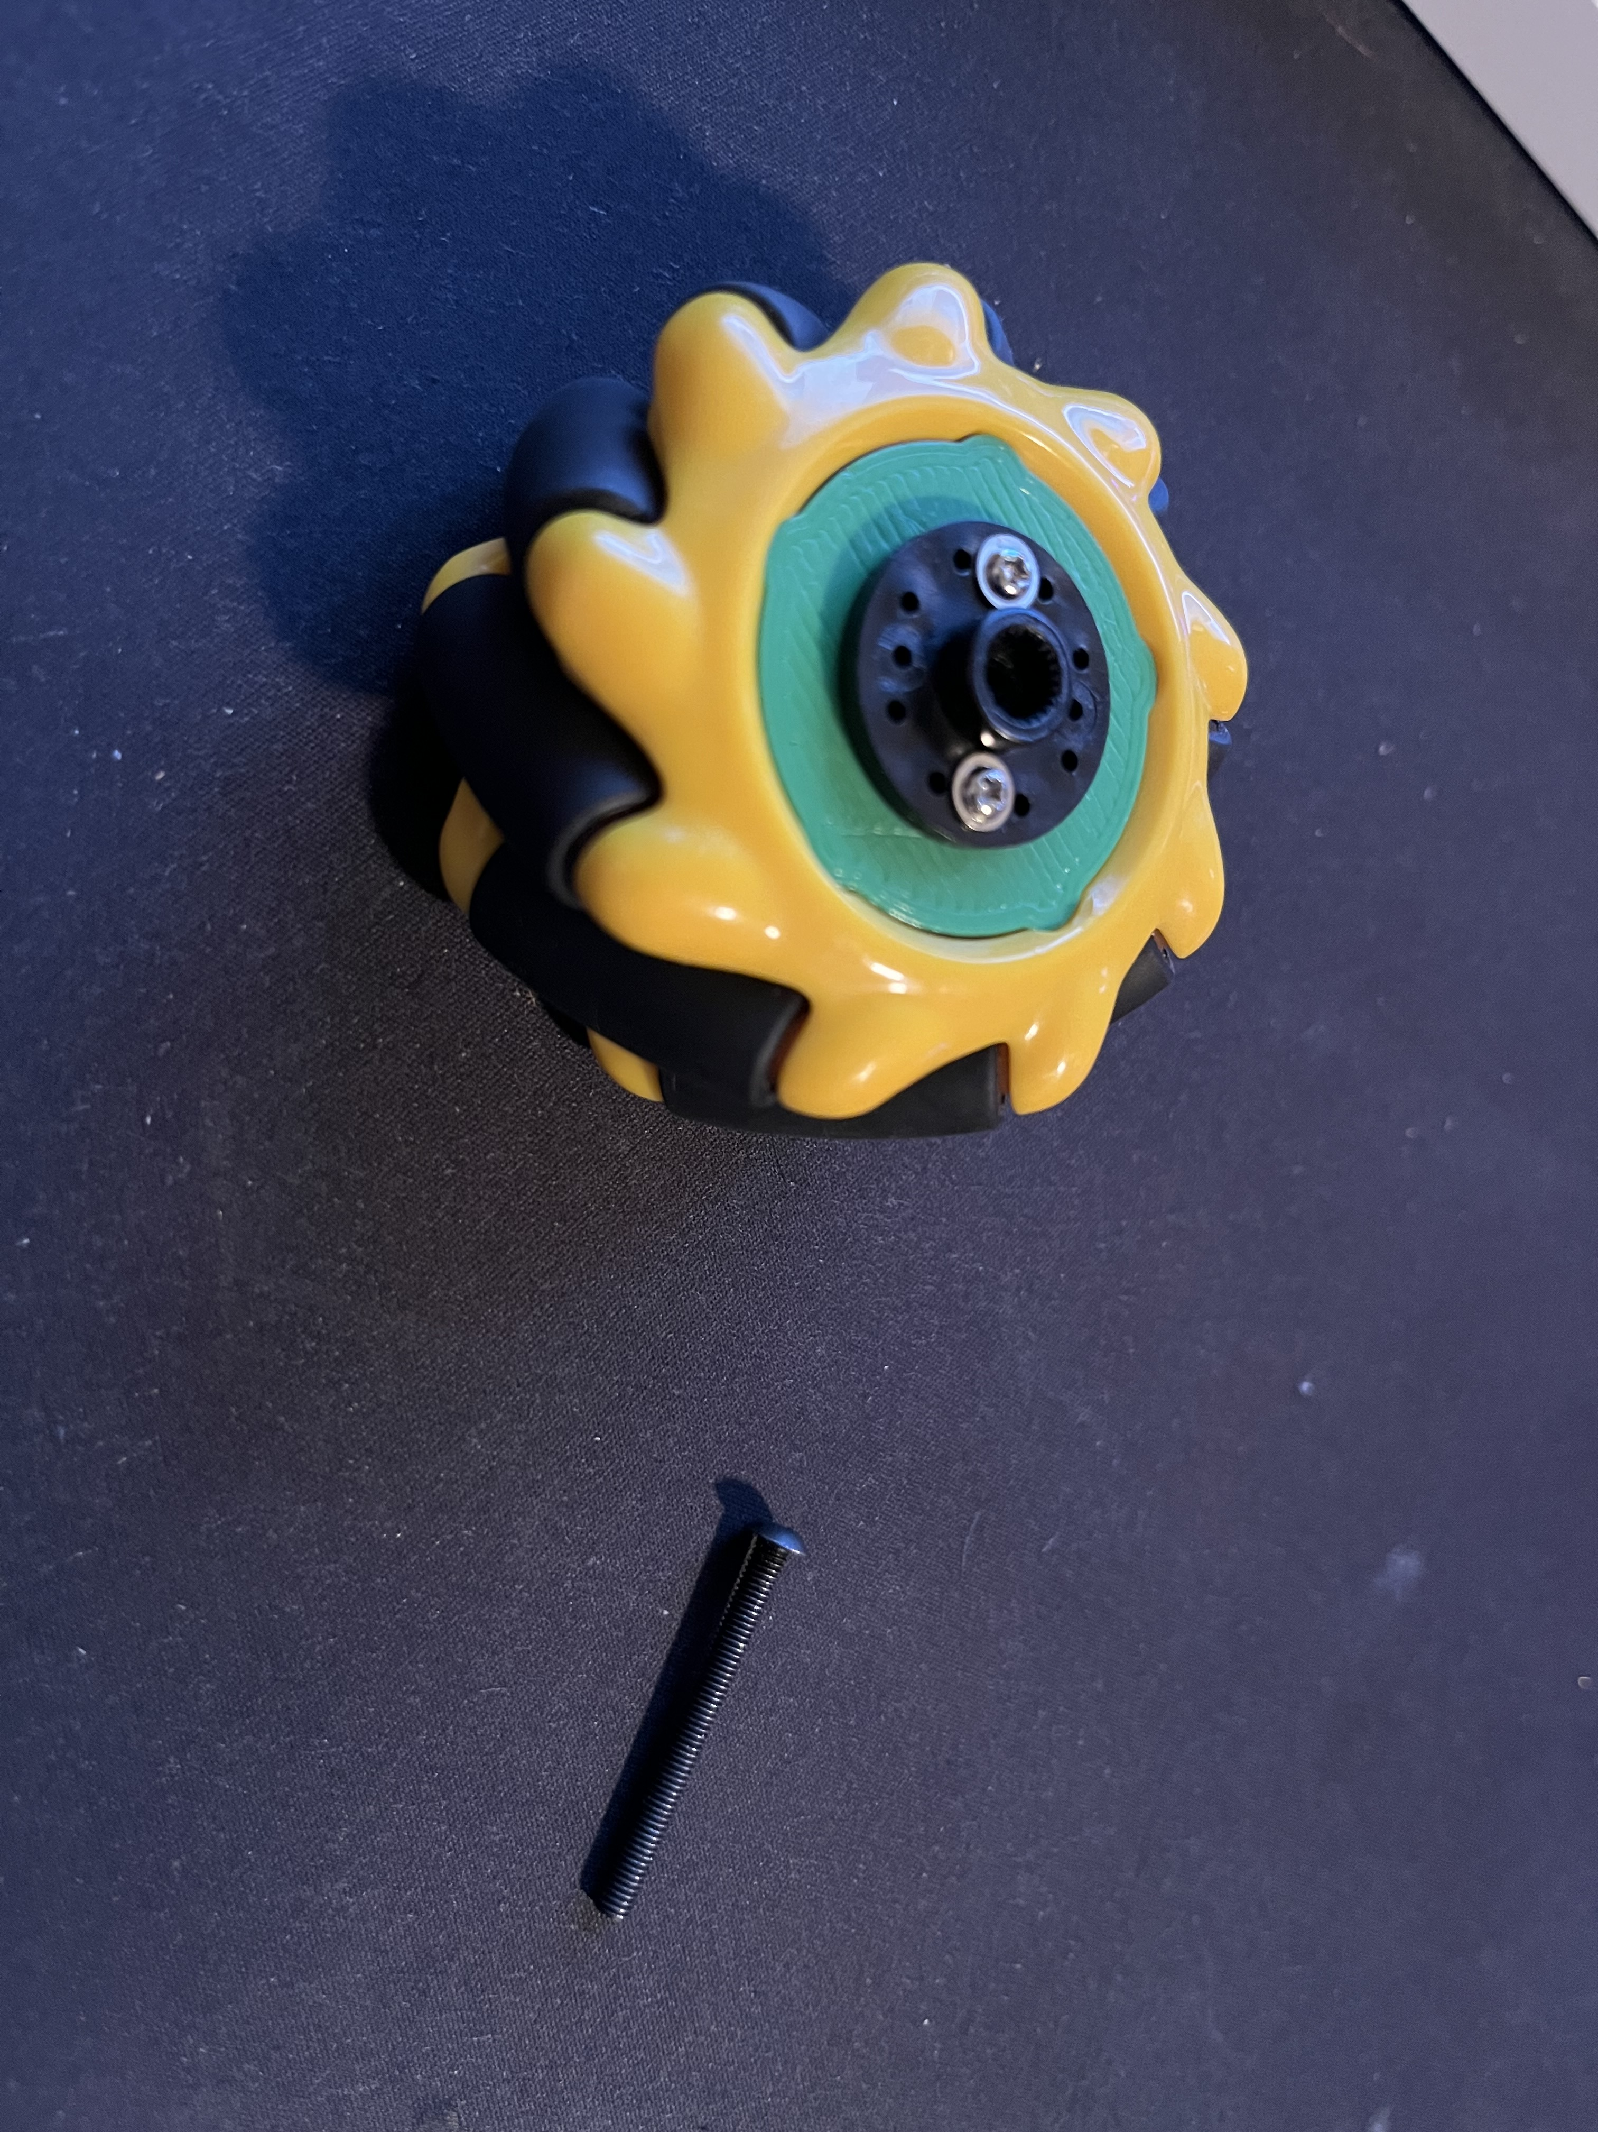
Mini Bot build Instructions
Parts:
4x Mecanum Wheels with included Servo adapters
Ensure a minimum of 2 screws are holding the servo adapter to the wheel!
4x M3 30mm long button head screw
Steps:
Gently press the wheel onto the servo hub, you may have to slightly rotate the wheel to align the splines
Secure the wheel in place with the M3 30mm long button head screw
Repeat 3 more times
PICTURE OF MINI BOT

Slide 11
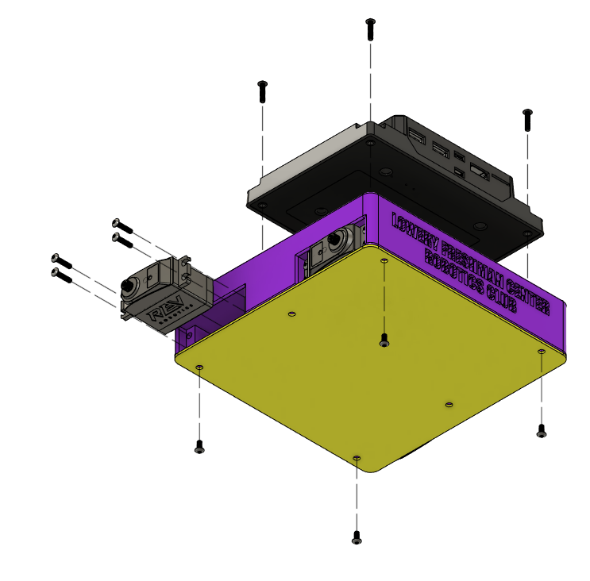
Mini Bot build instructions
Parts:
Bottom Lid
4x 4-40 ¼” long button head screw
Steps:
Align the lid with the mounting holes on the bottom of the chassis
Secure the lid with at least 4 4-40 ¼” long screws

Slide 12
Congratulations
Build complete!

